Slide 1
On the third day he rose again
It’s a new dawn..
It’s a new day..
It’s a new life..
John 20:1-10

Slide 2
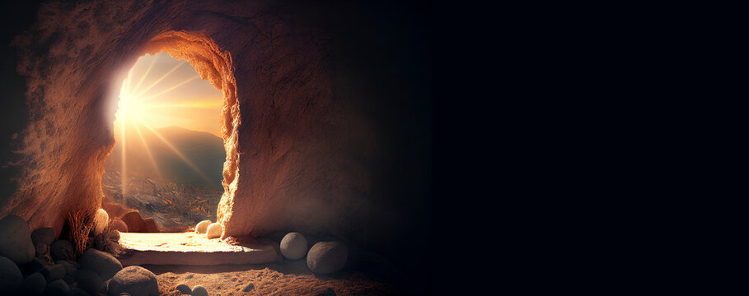
It’s A New Dawn
..for the Son is risen
John 20:1
Early on the first day of the week, while it was still dark,
Mary Magdalene went to the tomb and saw that the stone had been removed from the entrance.

Slide 3
It’s A New Day
..for his new creation
2 Cor 5:17
Therefore, if anyone is in Christ,
the new creation has come:
The old has gone, the new is here!

Slide 4
It’s A New Life
..for those that believe
John 11:25
“I am the resurrection and the life. The one who believes in me will live, even though they die;
and whoever lives by believing in me will never die.
Do you believe this?”

